Slide 1
What Determines the Price of a House?
Joey Romness

Slide 2
When Predicting a House’s Price, What Factors Impact Price Point the Most?
Notes:
In this presentation we'll be talking about what factors most influence housing prices
Preface: The inferences I'm about to make are based upon a prediction model I made where about 93% of the variation in House Sale price can be explained by the variables I chose to include in my model.
I know this sounds very complicated but essentially what I'm saying here is that the model I designed can predict house prices relatively accurately and it can do so because I was able to determine what factors most impacted Saleprice. There's a lot of fancy math and computer work involved in this process but that's not what we're here for today.
We're here to talk about WHAT factors influence price, and why they do so. So let's do that.

Slide 3

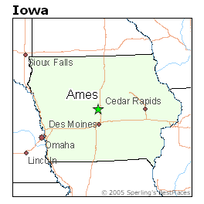
A Case Study of Ames Iowa Housing
All conclusions and inferences from this presentation were made after examination and analysis of the widely available Ames Housing Dataset.
Notes:
The data that we’ll be using today was gathered from Ames Iowa housing data. All conclusions and inferences that come from my model and from this presentation were made after examination and analysis of this dataset.
Image sources:
https://www.bestplaces.net/city/iowa/ames
https://upload.wikimedia.org/wikipedia/commons/thumb/1/15/Ames_Montage.jpg/250px-Ames_Montage.jpg

Slide 4
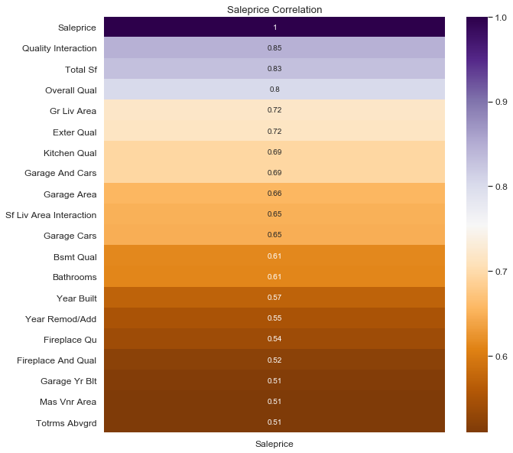
An Overview of What Most Determines the Sale Price of a House
Notes:
So there’s a lot on the screen right now but what I want you all to mostly pay attention to are the values at the top.
Values like Quality Interaction, Total Square Footage, Overall Quality, GR Liv Area (Ground Living Area Square Footage), Garage and Cars, Garage Area, and Square Footage of Living Areas are all highly correlated with Sale Price.
What this means is that as these values increase, the likelihood of a high saleprice also increases. As I hope you can infer from looking at this heatmap, Quality Interaction and Total Sf are the most correlated with saleprice, which means that increases in these variables have the highest probability of equating with an increase in SalePrice.
What’s the deal with the similar variable names and the interaction columns? Let’s get into that. >> NEXT SLIDE

Slide 5
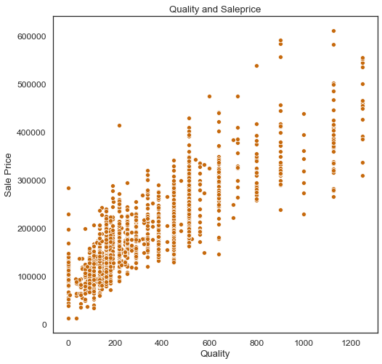
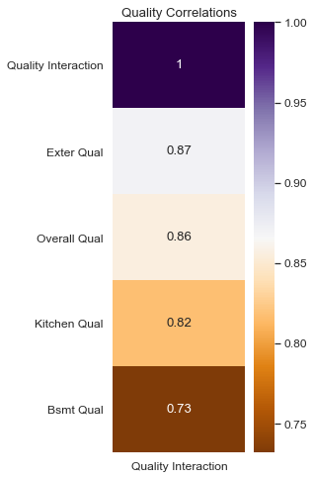
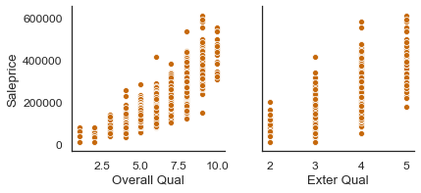
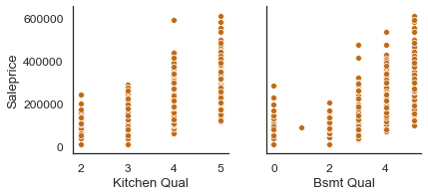
Quality Matters
Notes:
The First 4 Scatterplots here represent the relationship between Quality and Saleprice:
The first plot represent Overall material and finish quality
The second plot represent Basement Quality, which is indicated by the Height of the basement
The third plot represents Kitchen quality
The fourth plot represents Exterior material quality
As I’m sure you can observe, each of these variables is positively correlated with Sale-Price, as they increase SalePrice goes up.
All of this makes you think: are these variables related to each other? If a house has great Exterior Quality, Kitchen Quality, Basement Quality, and Overall Material Quality, will it simply be worth more? The answer to that question is generally YES. By accounting for the interaction between quality variables, we can more accurately predict Saleprice. What I’m saying is that the pattern between quality is, in itself, a factor that very accurately predicts house price.
And I have proof for this! This large scatterplot represents the pattern between Quality-Interaction and Saleprice, as you saw in the previous slide, Quality Interaction has the largest positive correlation with Saleprice!
More proof of this interaction lies within the heatmap present on this slide, which shows the correlation between the different quality variables what I want you to infer from that is that they are all HIGHLY correlated with one another. If one aspect of quality is high in a house, then it is likely that the others will be higher as well.

Slide 6
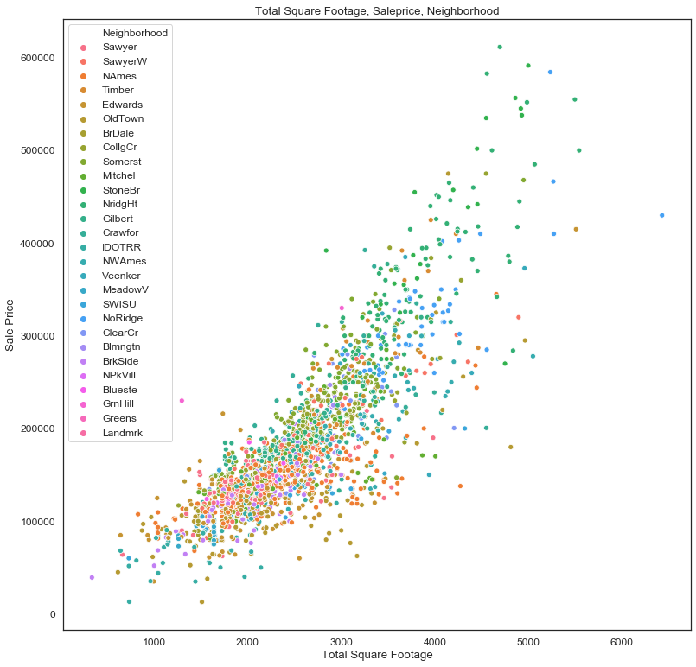
Size Matters… Does Neighborhood Matter?
Notes:
Ok so we’ve talked about quality and patterns between quality being highly correlated with price, but what about size? I’m sure that’s something that first comes to mind when thinking about house prices and what makes them go up or down.
Well if you thought that size increased house price, you are correct in that assessment. From the Ames housing data, I created a new data feature called Square Footage that takes all of the different square foot variables of a house and adds them together. This scatterplot almost speaks for itself. There is a CLEAR pattern between increase in Sq Footage and sale price… But what’s this here? Why are we talking about Neighborhood?
WELL. Let’s look at the colors on this scatterplot briefly. I know that our key has a ton of values BUT what I want you to notice is that some of these colors are clustered, or atleast more present in certain areas of the scatterplot. What could this indicate for our Saleprice?

Slide 7
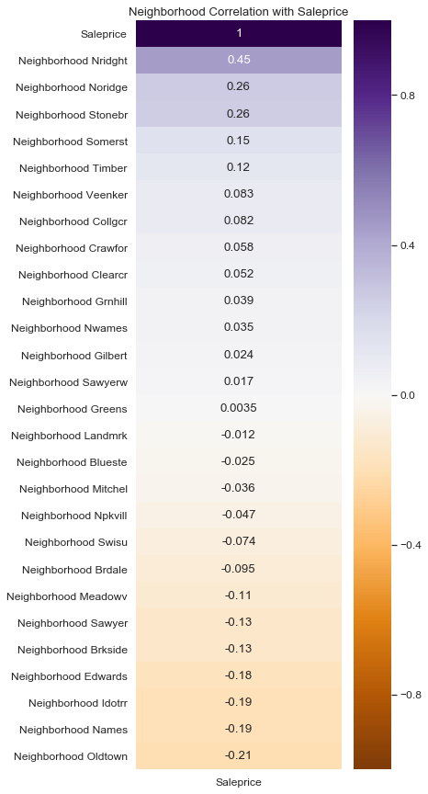
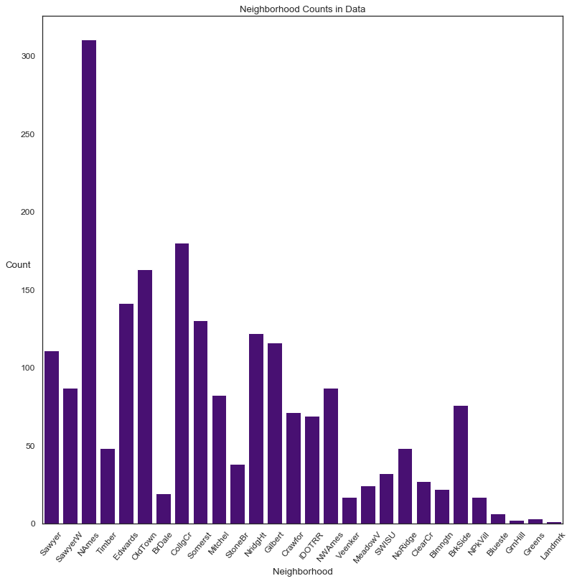
It does!
Notes:
Turns out… It plays a pretty big role on SalePrice.
On the left here is just a basic countplot showing the spread of neighborhoods in our data. This plot mostly exists because I want to show how sometimes seemingly ‘innocent’ categorical can play a larger role then one might initially expect.
On our right is another heatmap (I hope you like heatmaps!) showing Neighborhoods and their relation to saleprice. What I want you to observe and infer from this is that each Neighborhood impacts saleprice different. Some do so positively, some do so negatively.
What this is saying is that CERTAIN neighborhoods make houses more expensive and CERTAIN neighborhoods make houses less expensive.
None of these correlations are as high as Quality and Sq Footage but they are interesting and very impactful, nonetheless.

Slide 8
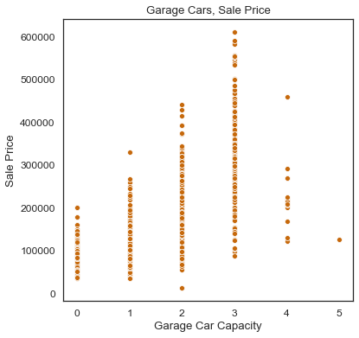
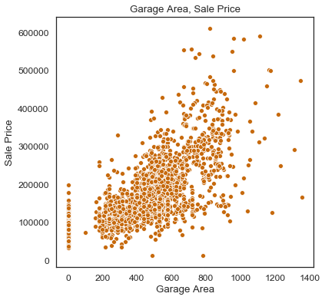
Let’s Cross-Examine Some Plots
Are there any noticeable patterns between these two plots?
Notes:
Now lets move onto my final point here for this presentation. I want us to look at some more scatterplots.
The plot on the left examines the relationship between Garage Car Capacity and Sale price
The plot on the right examines the relationship between Garage Area and Sale price
Do you notice any patterns between these?

Slide 9
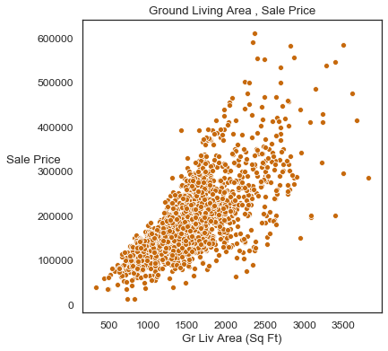
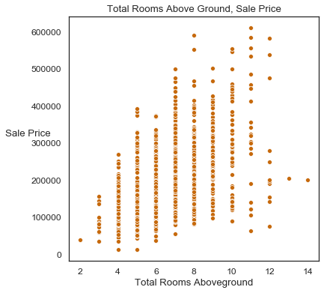
What About Here?
Notes:
Here are two more.
The plot on the left examines the relationship between Ground Living Area and Saleprice
The plot on the right examines the relationship between Total Rooms Aboveground and Saleprice
What about these plots? Is there a pattern here?

Slide 10
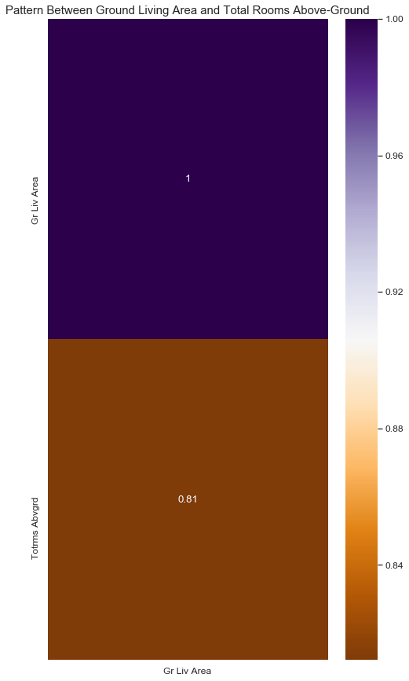
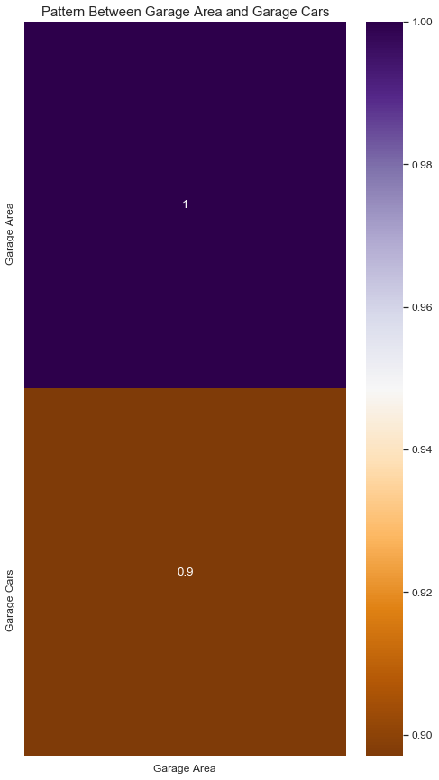
Notes:
Turns out, yes! Much like quality, both of these variable sets are not only highly correlated with saleprice but they are highly correlated with one another. They are interactive!
Let’s think about this briefly: A garage that is not only large but also able to fit multiple cars will likely cause a house price to increase as will a house that has not only multiple rooms at ground level, but also rooms that are large and spacious.
SO whats my point here?

Slide 11
Finding Patterns and Figuring Out How to Make Sense of Them and Account for Them is Vastly Important for Determining House Price.
Notes:
My point is that finding patterns and figuring out how to make sense of them and account for them is vastly important for determining a house’s price. Had I not noticed and accounted for the patterns in different housing data variables, my prediction model would have been nowhere near as accurate as it is.

Slide 12
Conclusions
When predicting housing prices (at least in the case of Ames, Iowa) the most important overall factors are Quality and Area. Despite how simple this may sound, the way these factors interact with one another can cause housing price to change significantly. It is important to recognize patterns case by case for each individual house in order to determine what its sale price will be.
Notes:
When predicting housing prices (at least in the case of Ames, Iowa) the most important overall factors are House Quality and House Area(In Square Feet). Despite how simple this may sound, the way these factors interact with one another can cause housing price to change significantly. It is important to recognize patterns case by case for each individual house in order to determine what its sale price will be.
I’d also like to end by saying what I’ve covered here is just the tip of the iceberg. When it comes to housing price determination, there is a lot more at play then just Quality and Area. These may be the LARGEST predictors of housing price, but that is not to say they are the only ones.

